Slide 1
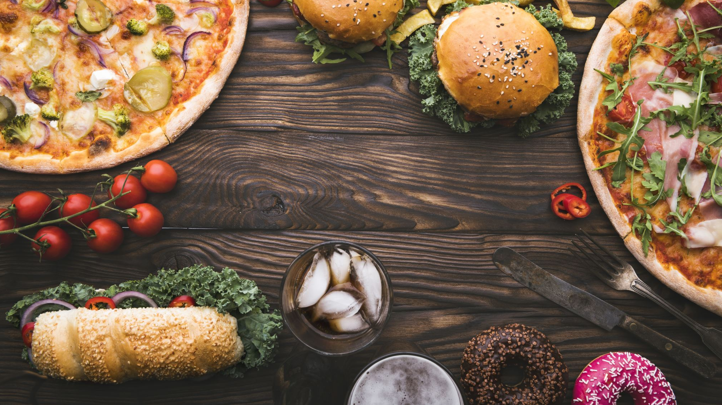
Personalized Food ordering System
A Web Application

Slide 2
Overview
Introduction
Problem statement
Study on the existing system
Design methodology
Implementation
Timeline chart
References

Slide 3
Introduction
A Web application which enables Customers to order various food products through online portal.
The customers can see all products available and make orders accordingly.
Customers can see the past orders and can cancel the current order if they wish to cancel.

Slide 4
Problem statement
If a person want to purchase food then he has to manually visit the food store and buy.
The paper work is really high and more employees are needed if customers are more.
The efficiency will be very low if everything is done manually.

Slide 5
Study On The Existing System
The currently existing system can be classified into 3 types
Visiting the restaurants manually
Ordering over a phone call
Ordering using apps

Slide 6
Design methodology
Login module
User login
User registration
User module
View previous orders
Cancel current orders
View & Edit Personal Details
Products module
List of products
Product details
Shopping module
Products in cart
Quantity of each product
Payment module
Print Receipt

Slide 7
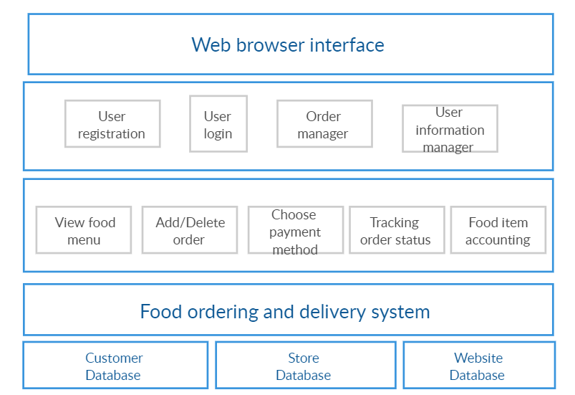
Architecture

Slide 8
Technological stack
Frontend
Html,CSS,JS
Backend
Django
Database
MYSQL

Slide 9
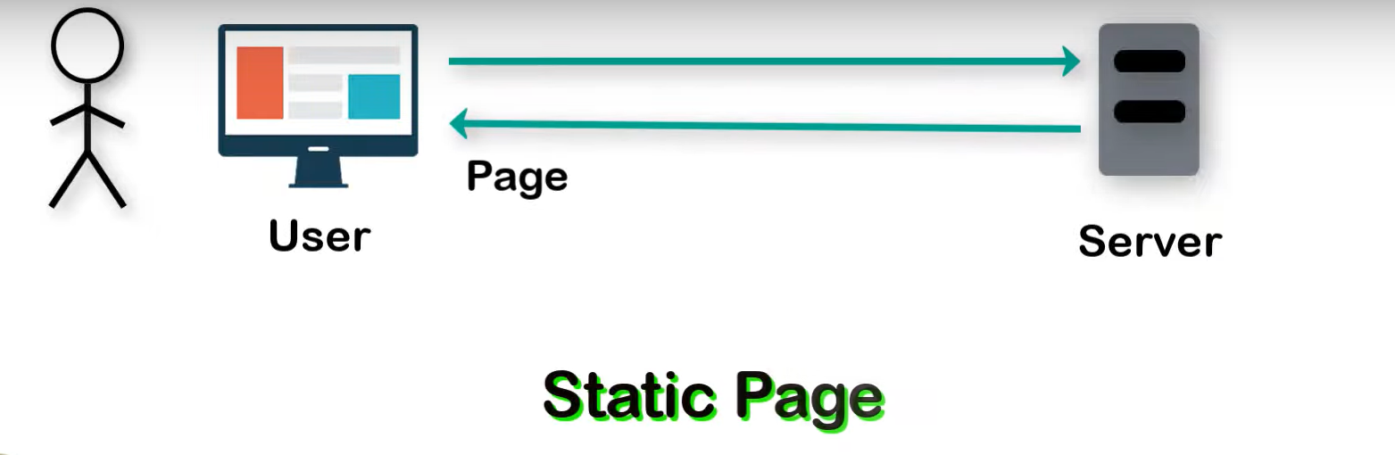
Data Flow

Slide 10
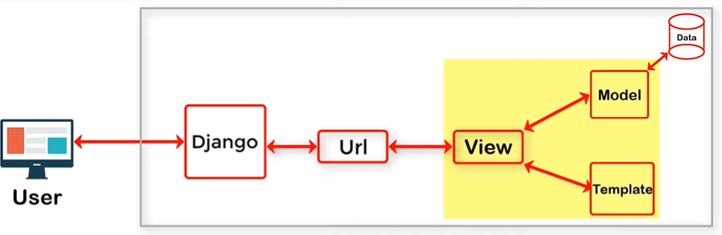
Django MVT Architecture

Slide 11
Implementation

Slide 12
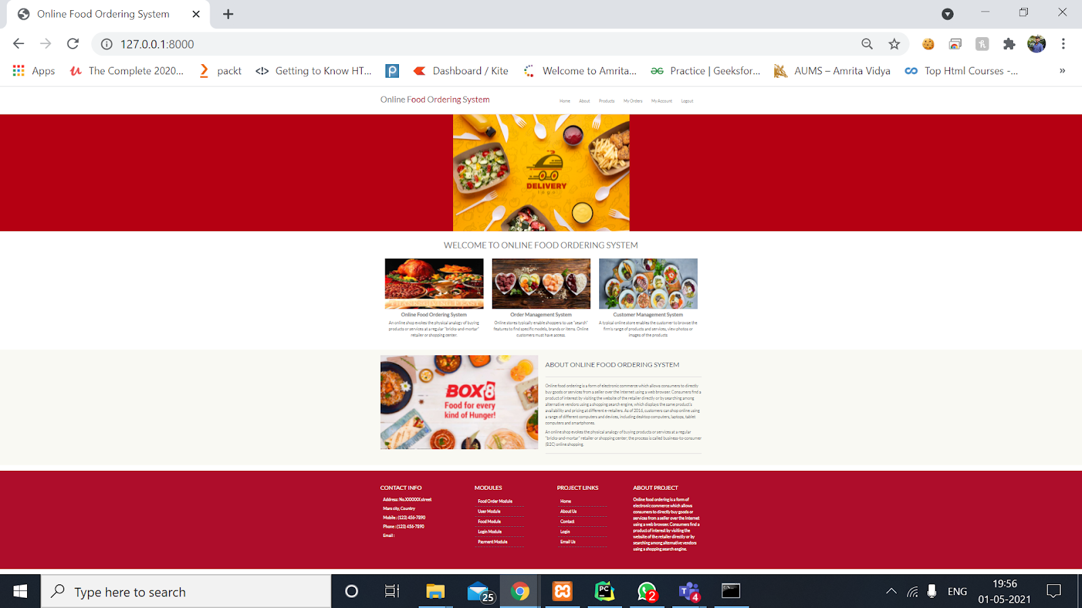
Home

Slide 13
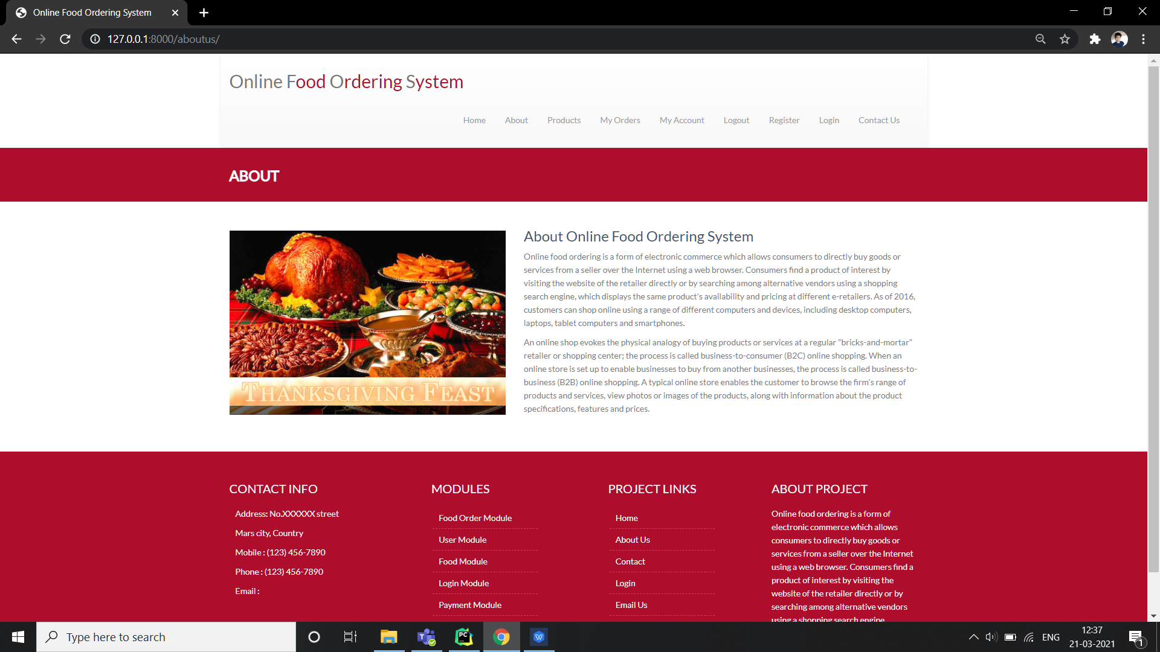
About Us

Slide 14
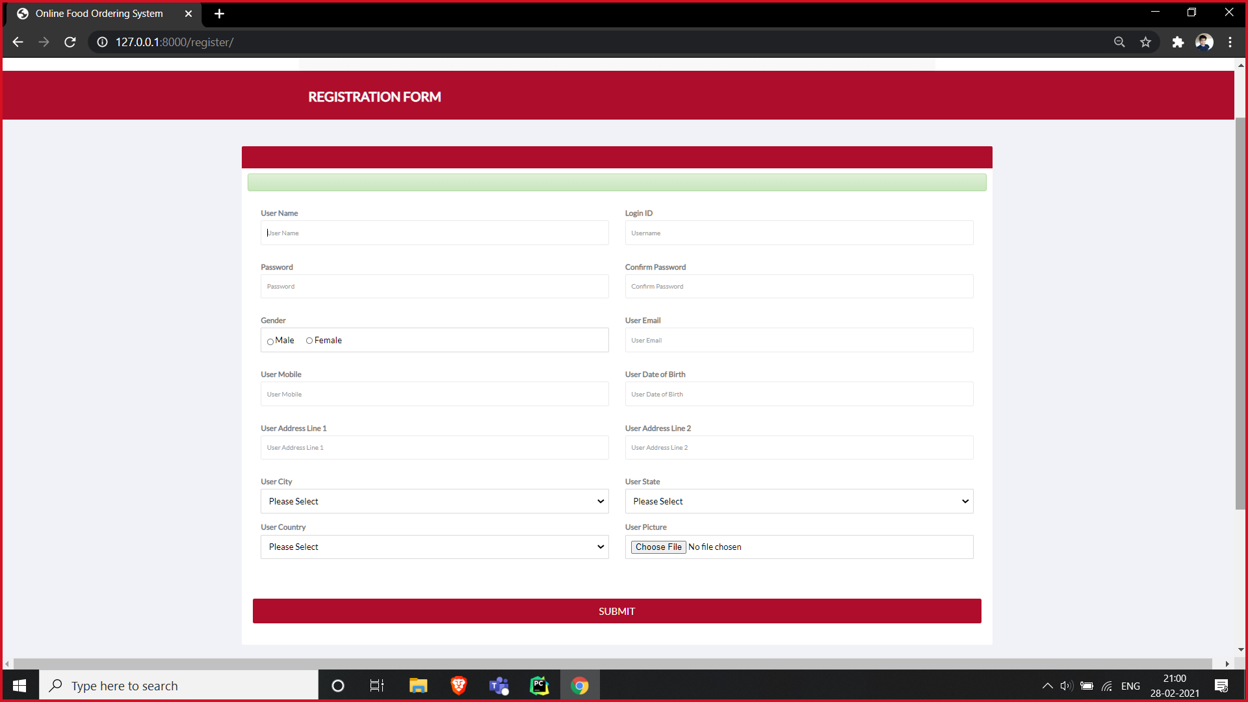
User Registration

Slide 15
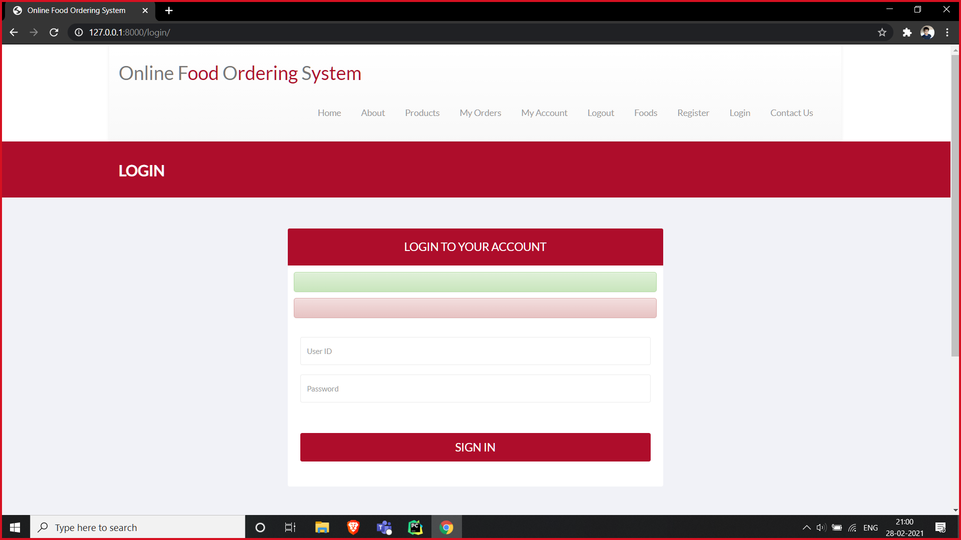
Login

Slide 16
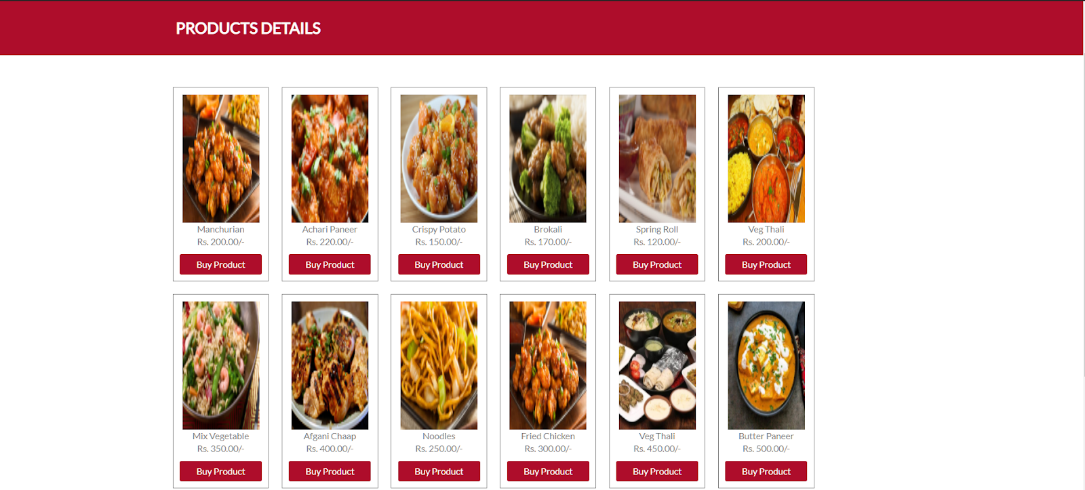
Products

Slide 17
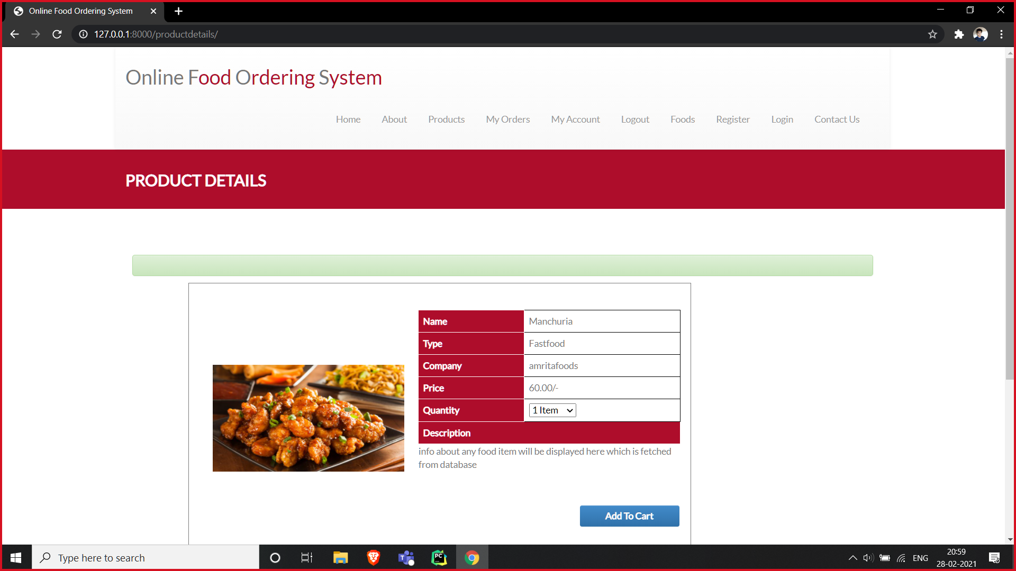
Product details

Slide 18
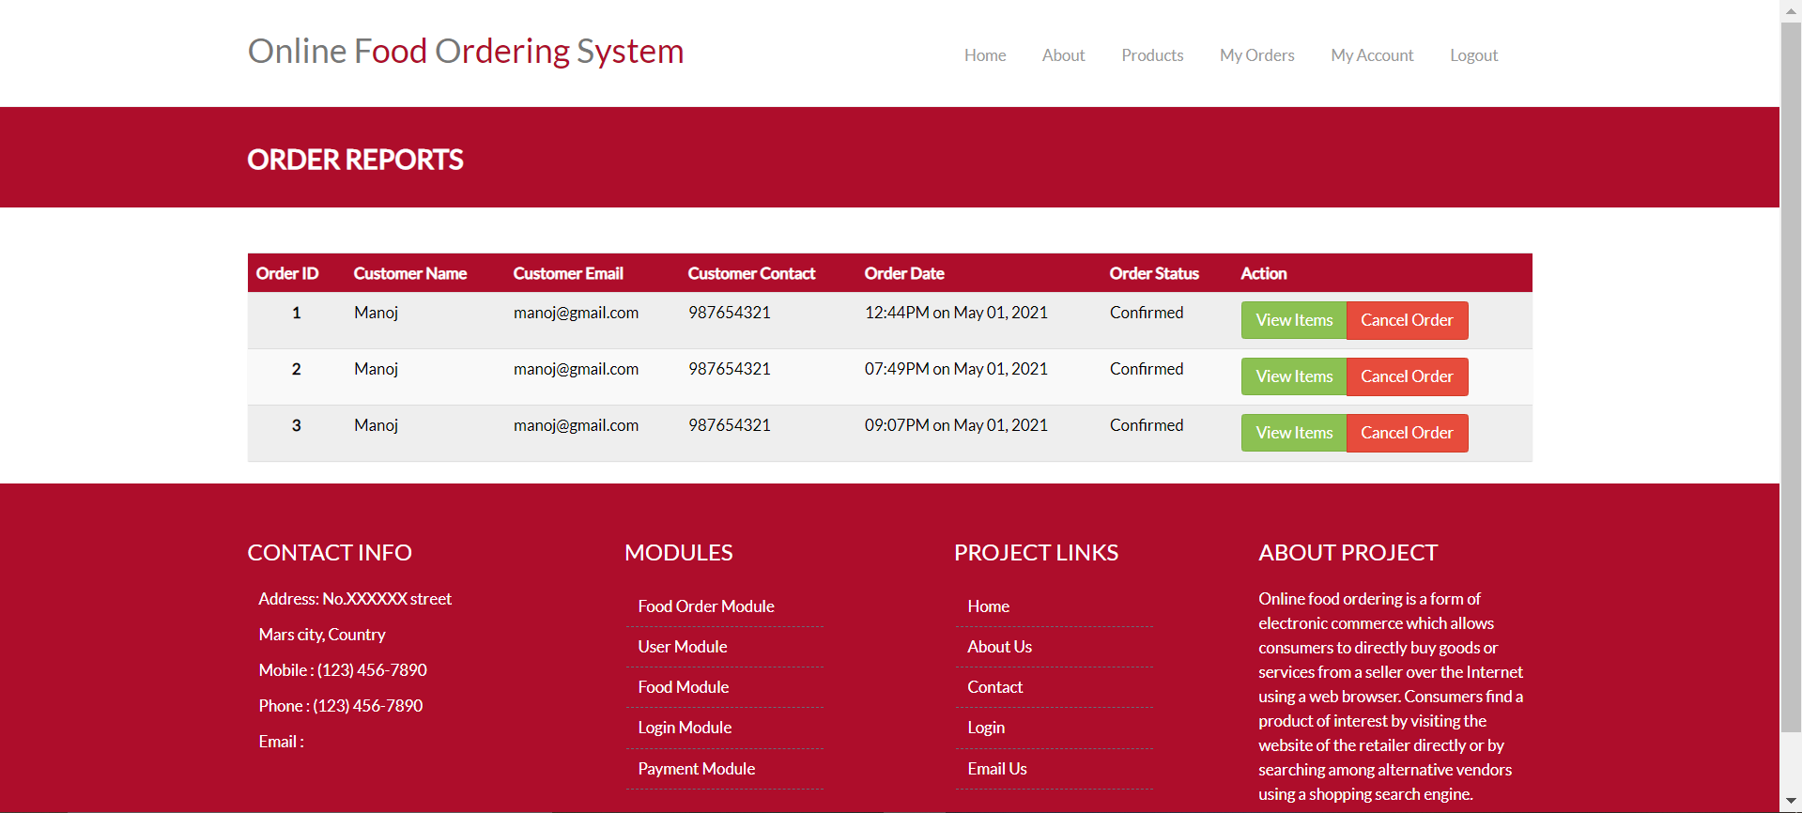
My Orders

Slide 19
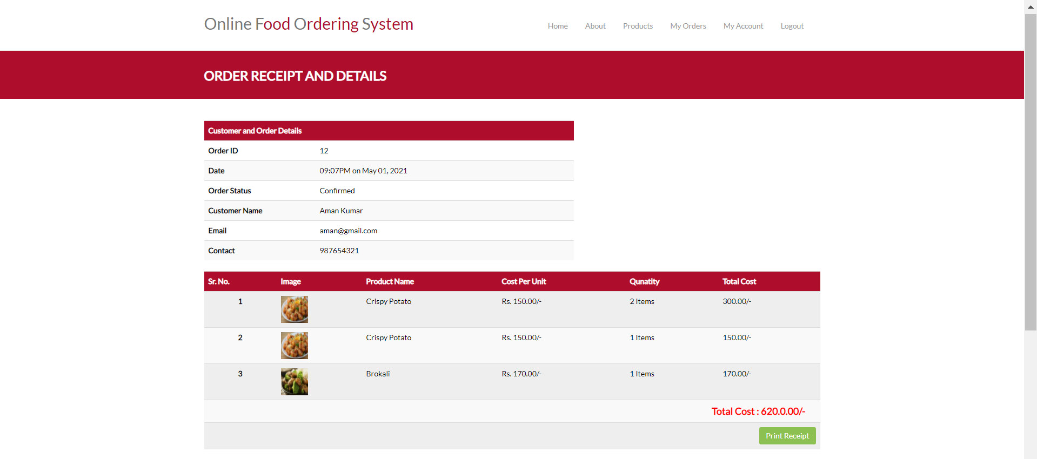
Order Details

Slide 20
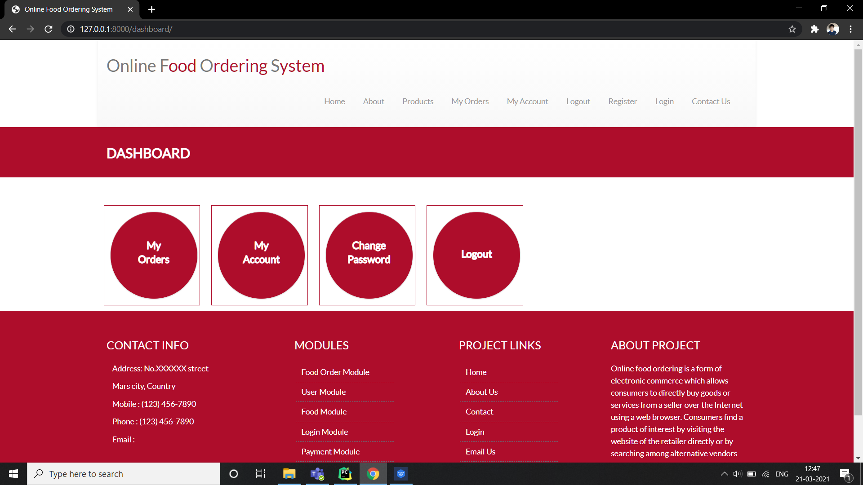
Dashboard

Slide 21
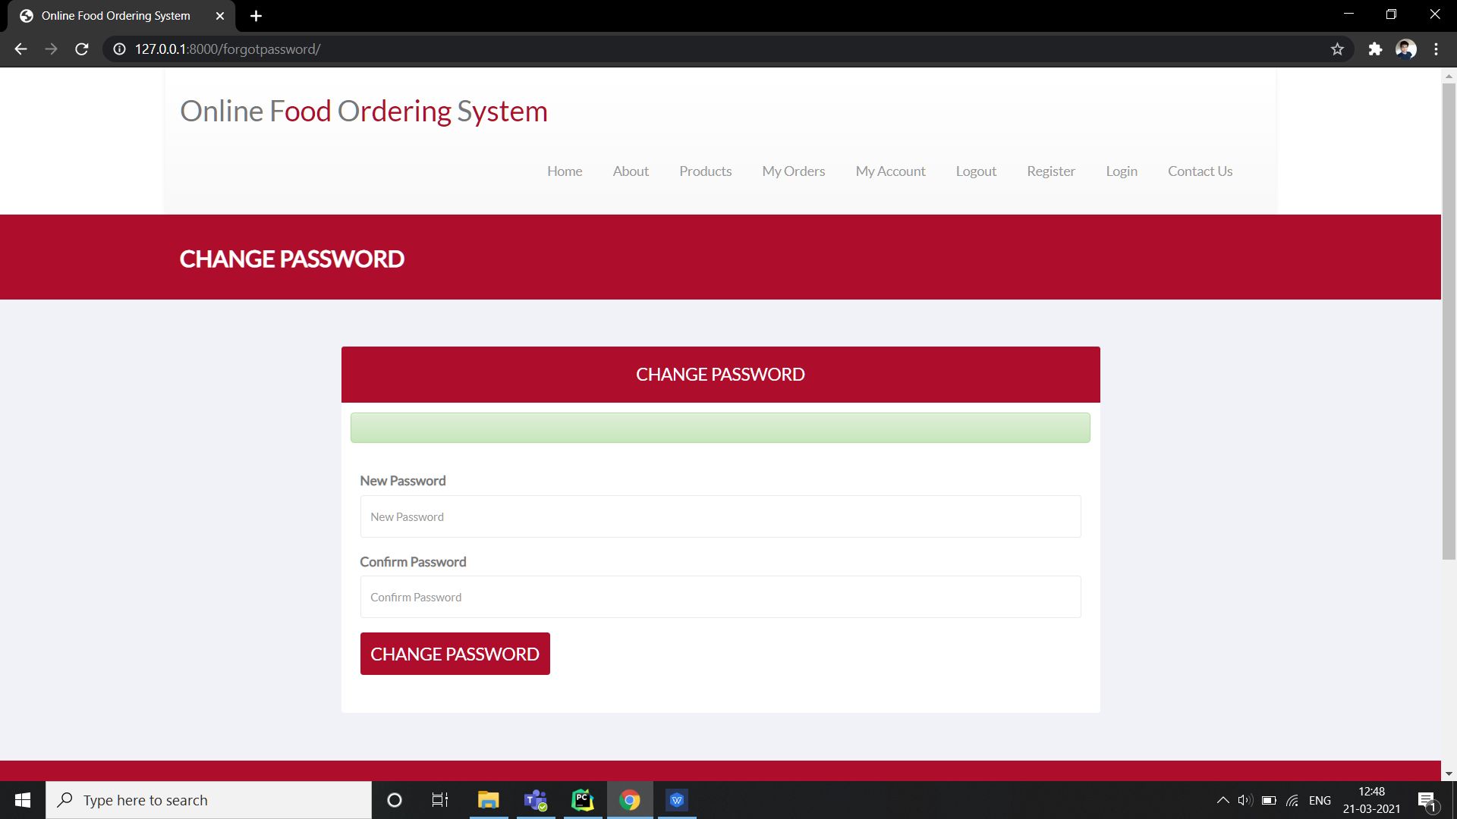
Change Password

Slide 22
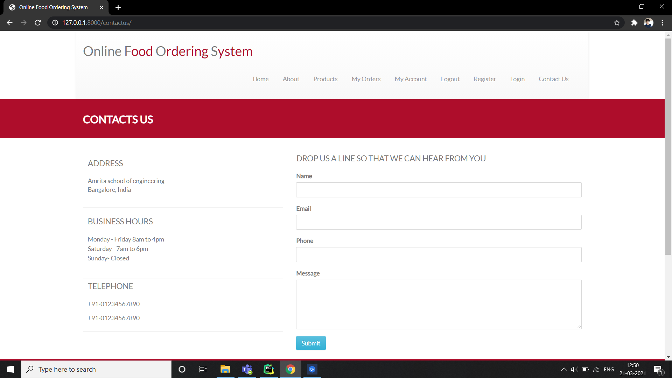
Contact Us

Slide 23
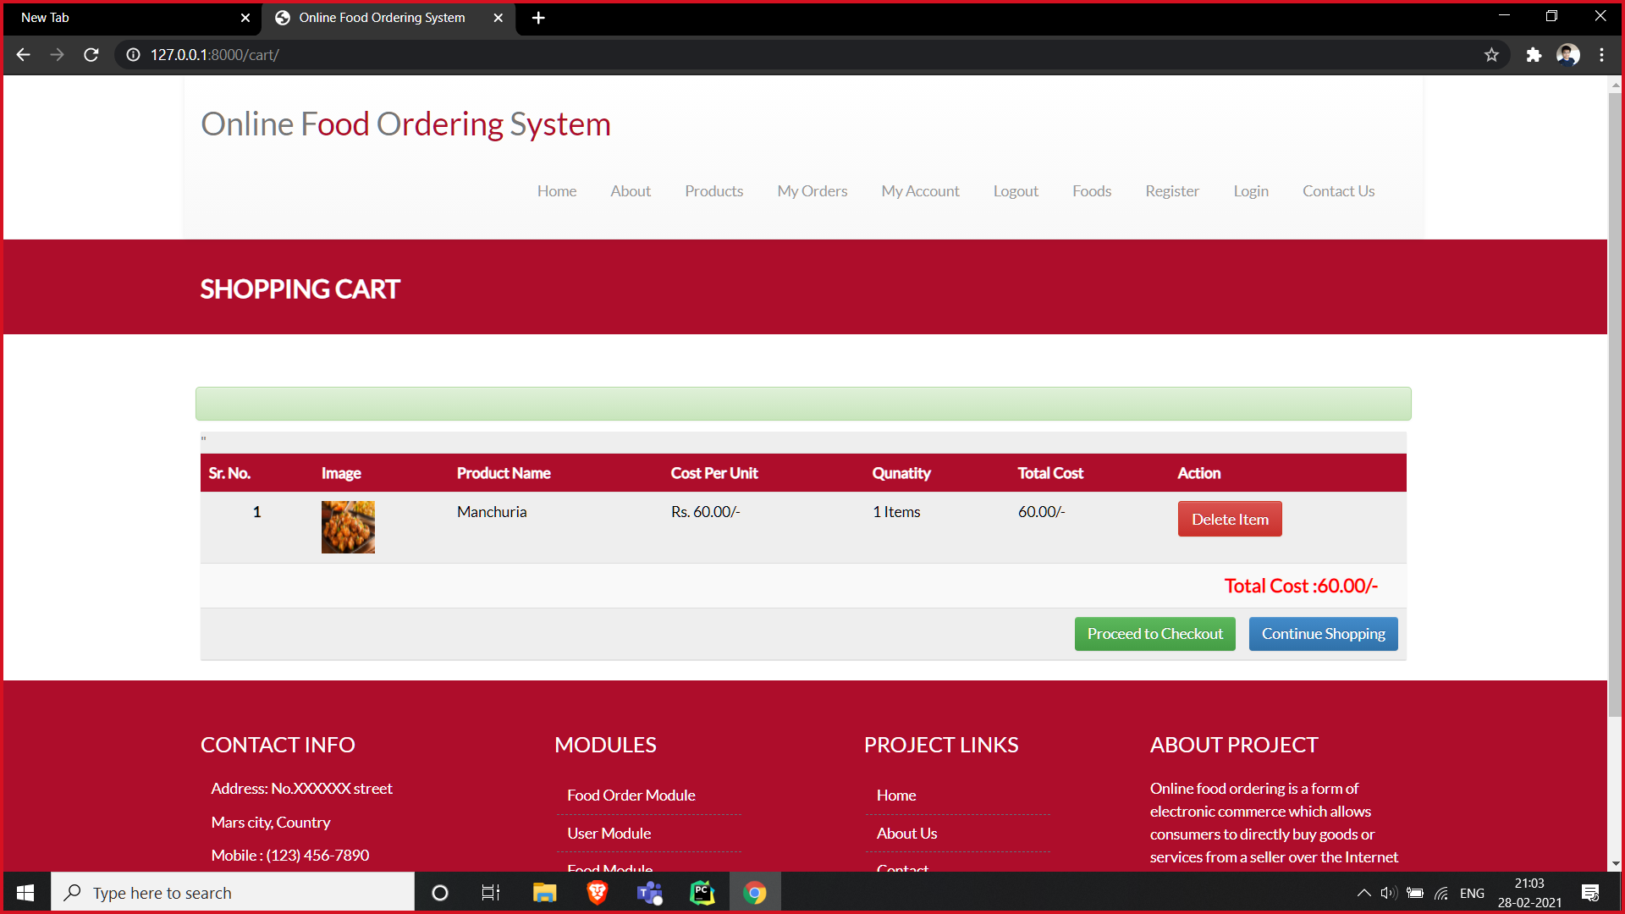
Shopping cart module

Slide 24
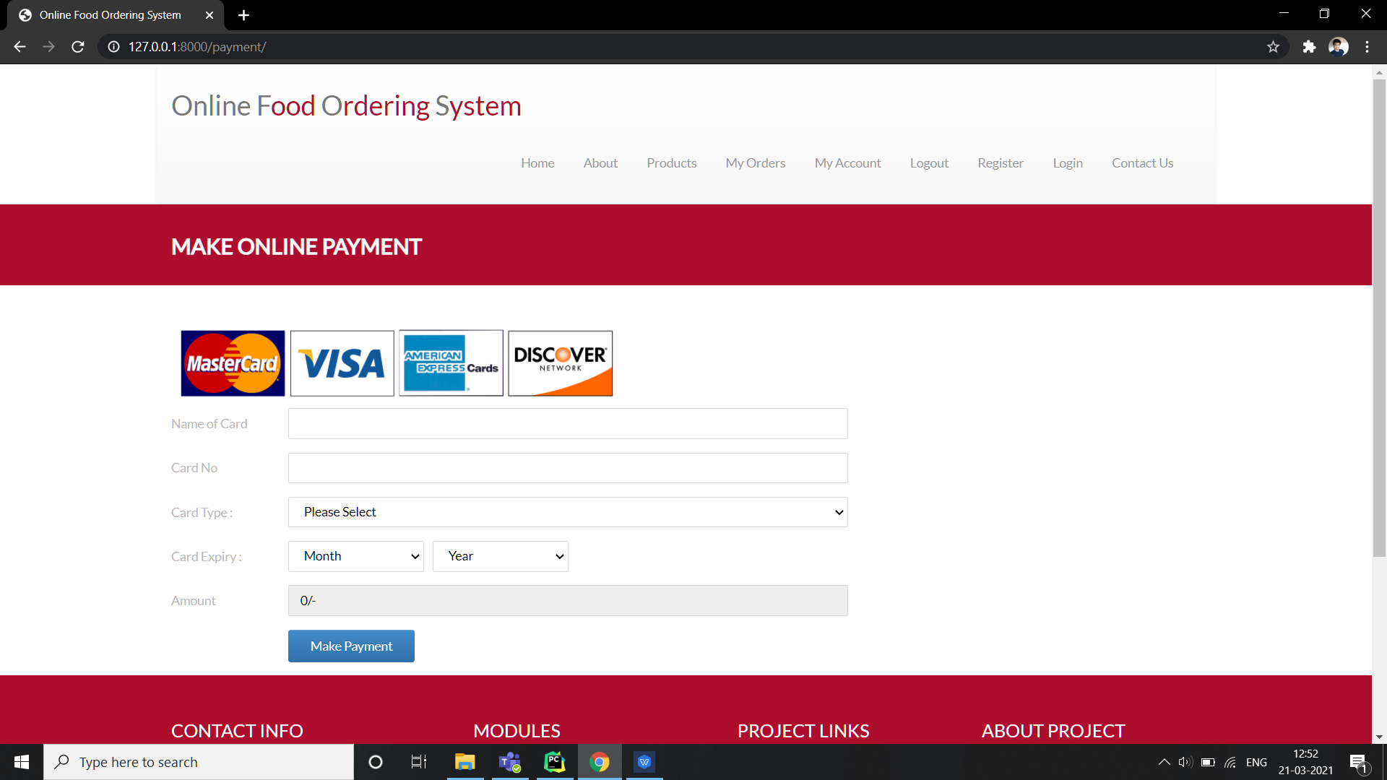
Payment

Slide 25
Timeline Chart
Environment setup to build the project
Learning prerequisites
Front end development
Database design
Integration with frontend
Testing and deployment
Error detection and improvement
Week 1
Week 2-3
Week 4-7
Week 8-9
Week 10-13
Week 14-15
Week 15

Slide 26
Individual Contribution
Team member | Contribution
V. Manoj Sai prakash | Login ,Register, My orders
Ch. Yuvateja | Home, Products display, Order details
R. Dhruwanth Reddy | Product Details, About us, Payment
I. Venkat Dinesh | Shopping Cart, Dashboard,

Slide 27
Conclusion
In an online food ordering system, an online menu is set up and the customers can easily place orders. Also with an online food menu, tracking the orders is done easily, it maintains the customer’s database and improves the food delivery service. The restaurants can even customize online restaurant menus and upload images easily. Having a restaurant menu on the internet, potential customers can easily access it and place orders at their convenience.

Slide 28
Future scope
The module of stock maintenance and raw material management can be added to the existing system to ease the work of restaurant admin. Enhance user interface by including more interactive features. Allow customers to customize their orders. We can also add different payment options such as Google Pay, PhonePe etc. We can also add a feature to see live order status and provide deals to influence customer regularity.

Slide 29
Learnings
Python
Django web framework
HTML
CSS
References
https://docs.djangoproject.com/en/3.1/
https://blog.getbootstrap.com/2016/07/25/bootstrap-3-3-7-released/
https://www.irjet.net/archives/V5/i6/IRJET-V5I679 : Journal (IRJET)

